Slide 1
Capstone 1 Consumer Complaints - Case Study
GROUP C
Aiman Mukhtar - Muhammad Waleed Yasin - Umair Khalid -
Osama Yusuf Hassan - Ghazi Haider

Slide 2
Introduction
Consumer complaints dataset provided by CFPB.
Why have we chosen this dataset?
What is CFPB?
CFPB is the Consumer Financial Protection Bureau, a U.S. government agency dedicated to making sure you are treated fairly by banks, lenders and other financial institutions.
Notes:
We have a selected Consumer Complaints dataset which presents consumers' financial complaints. These complaints have been collected by the Consumer Financial Protection Bureau (CFPB).
The reason behind selecting this dataset is that we intend to determine how analysis was performed on complaints, how it has impacted the business to grow and the pertaining factors that have been measured in case of complaints.

Slide 3
About Dataset
Consumer complaints dataset have around 18 attributes and 65500 records.
Complaint_ID is the primary Key.
Tags, Consumer Consent Provided,Company Public Response, Consumer Complaint Narrative fields are not used in our analysis because around 80% of data is NULL.

Slide 4
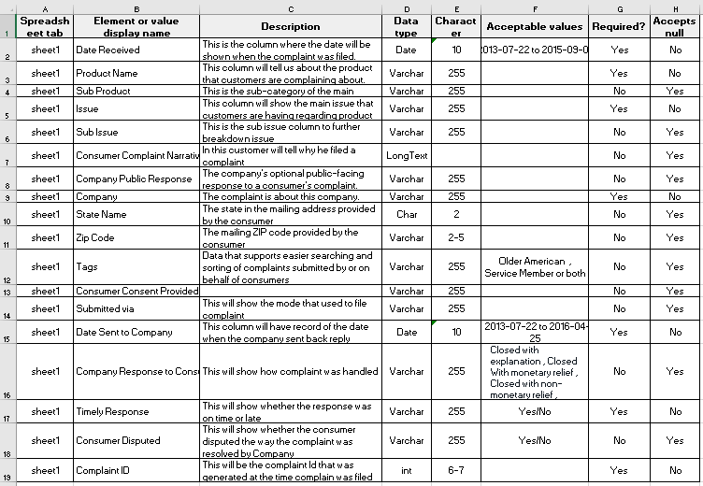
Data Dictionary

Slide 5
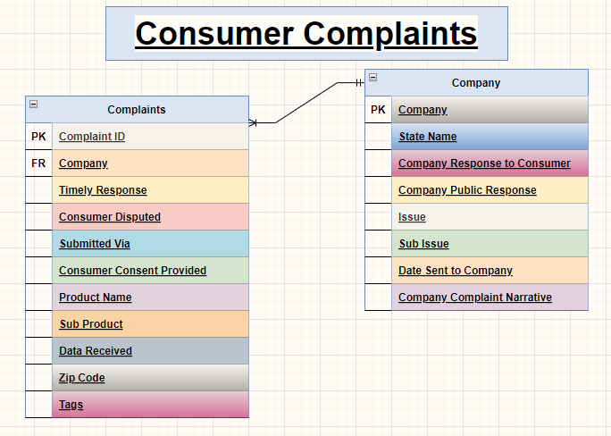
Entity Relationship Diagram (ERD)

Slide 6

Business Problem
The Academic Research Council of Consumer Financial Protection Bureau (CFPB) is meeting to publish the annual Consumer Complaint Report published.
The agenda of this meeting involves:Analyzing the trends of consumer complaints across the US.
Dissecting the consumer complaints data updated in the Consumer Complaints Database and deriving insights from it.
Proposing measures to mitigate consumer complaints and ensure customer satisfaction.

Slide 7
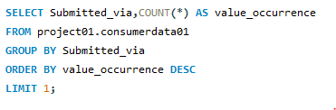

The customers lodge their complaints through various modes of submission. The research team decides to identify the most frequent mode of submission in order to ensure that the respective team is equipped reasonably.
Please run a query to identify the mode of submission adopted most frequently by customers.
QUERY :
RESULT :

Slide 8
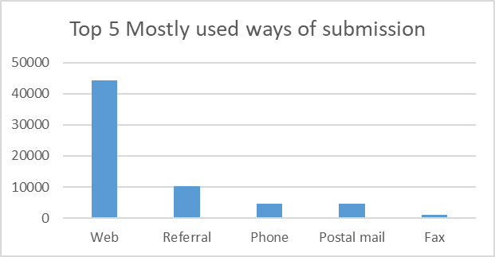
Visualization using Vertical Bar Graph:

Slide 9
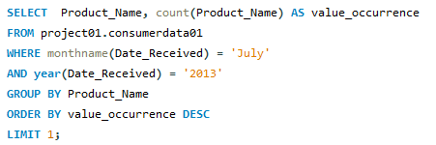

2.
Next on the research team decides to figure out the product which has received the most number of complain in a specific month of a specific year.
Run a query for this.
QUERY :
RESULT :

Slide 10
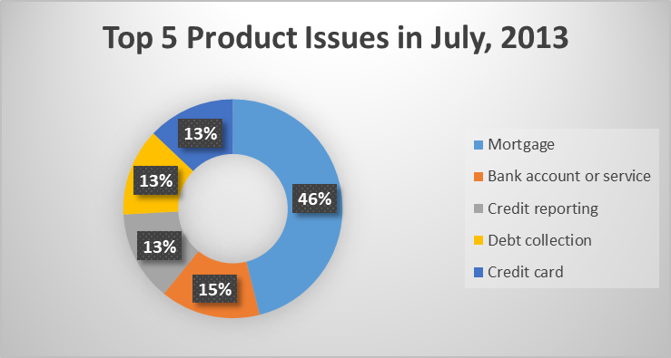
Visualization using Donut Chart:

Slide 11
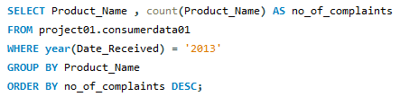
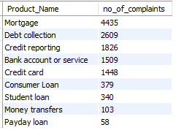
3.
Once the research team has performed a month by month analysis, it proceeds on to perform an year by year analysis on each product and numbers of complaints associated with it.
Run a query that returns the list of product along with with the number of complaints each product receives year by year.
QUERY :
RESULT :

Slide 12
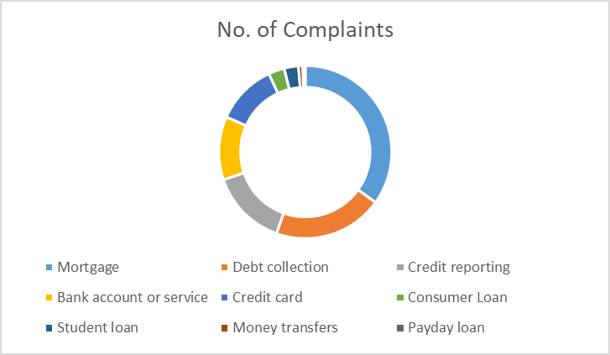
Visualization using Donut Chart:
Number of Complaints By Product

Slide 13
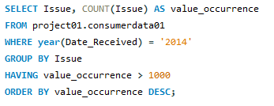
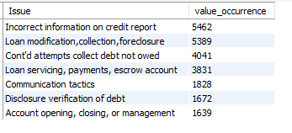
4.
Once the research team has performed a month by month analysis, it proceeds on to ascertain the key issues and their number of occurrences in each year.
Run a query to return the key issues ordered by their number of occurrences (from highest to the lowest) year by year.
QUERY :
RESULT :

Slide 14
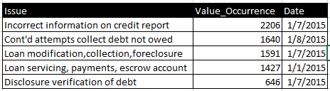
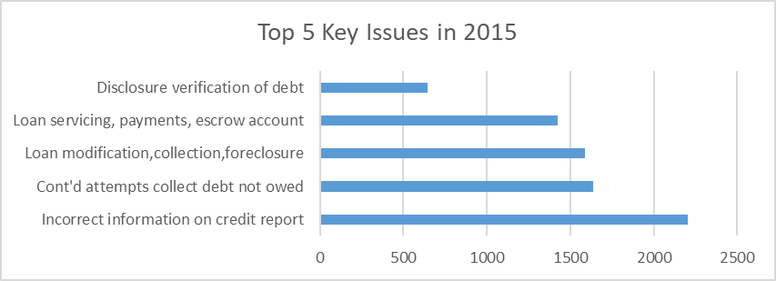
Visualization using Horizontal Bar Graph:

Slide 15
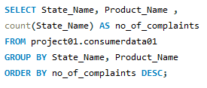
5.
Moving on, the research team decides to assess the complaints intensity for every product in each state.
Write a query that returns the number of complaints received by every state for each product separately.
QUERY :

Slide 16
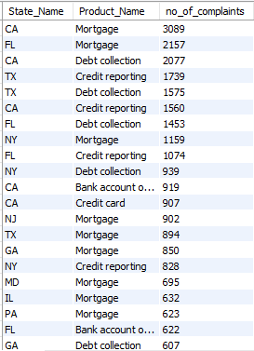
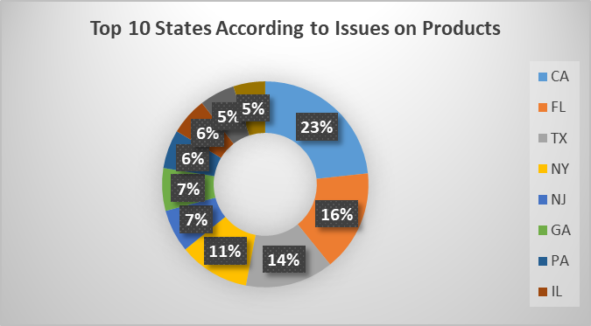
RESULT :
Visualization using Donut Chart:

Slide 17

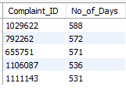
6.
During the course of meeting, the research team observes that it took unusually long for some complaints to be addressed. After an in-depth investigation it was discovered that it took several days for those complaints to be forwarded to their respective financial companies.
Write a query that returns ID number of top 5 complaints that took the longest to be forwarded their financial companies once received. Also return the number of days before they were forwarded.
QUERY :
RESULT :

Slide 18
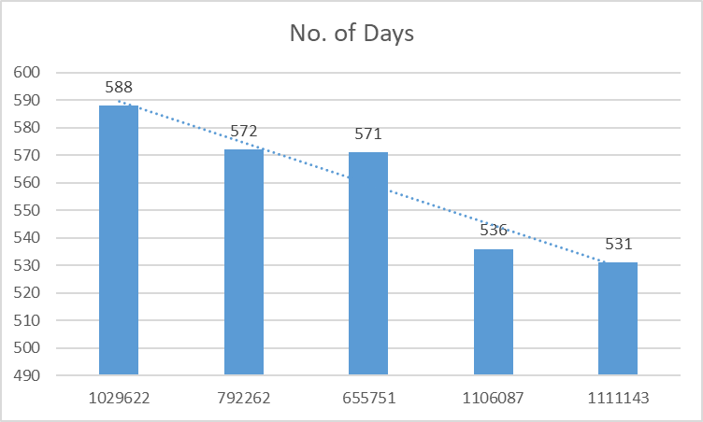
Visualization using Bar Graph:
Complaints_IDs that take most time be forwarded

Slide 19

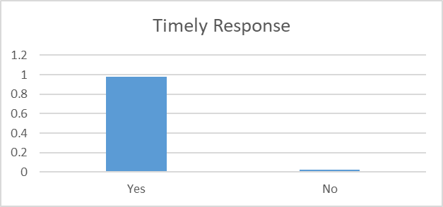

7.
Moving onwards the research team attempts to study the performance of each department.
Write a query to return the consumer timely response rate.
QUERY :
Visualization using Vertical Bar Graph:
RESULT :

Slide 20


8.
Now the research team has to evaluate the performance of customer care team. It decides it will base it evaluation on customer complaints dispute rate. If the dispute rate is high it will they will have to work on improving the customer care team performance.
Write a query to return that consumer complaints dispute rate.
QUERY :
RESULT :

Slide 21


9.
Similarly, the team computes the consumer complaint resolution rate to assess the performance of customer care team
Write a query to return the consumer complaint resolution rate.
QUERY :
RESULT :

Slide 22
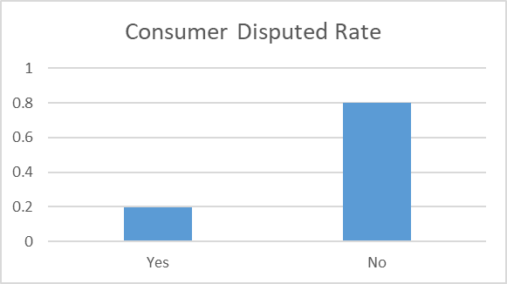
Visualization using Vertical Bar Chart:

Slide 23
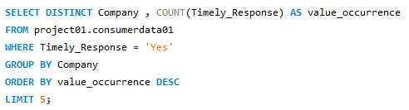
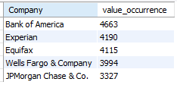
10.
The research team wants to publish a list of the most responsive companies. The company with the most numbers of timely response by their customer team will be part of the list.
Write a query to return the names of top 5 most responsive companies. Also, return the number of responses each of them has made.
QUERY :
RESULT :
RESULT :

Slide 24
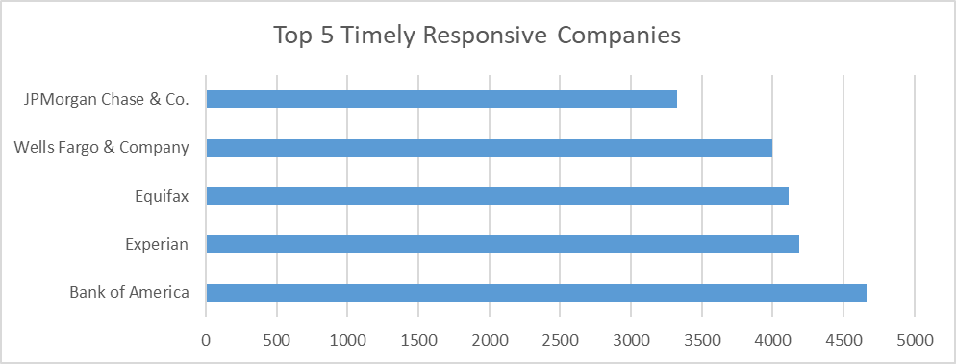
Visualization using Horizontal Bar Graph:

Slide 25
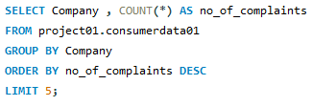
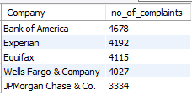
11.
Also, the research team decides to offer its expert advice to companies which have received most complaints for their products. This will help the team in identifying which companies needs the most help.
Run a query that return the top 5 companies with most number of complaints. Also, return the number of complaint each of them has received.
QUERY :
RESULT :

Slide 26
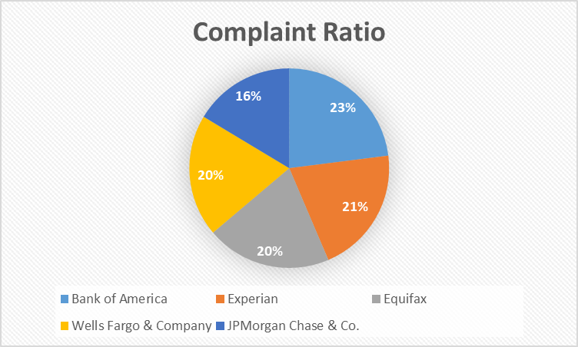
Visualization using Pie Chart:

Slide 27
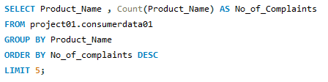
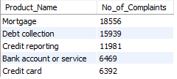
12.
The research team plans on identifying the product which have most number of complaints associated with them. This will help them investigate any shortcomings related to those products so that they could mitigate the prevailing issues.
Run a query that return the top 5 products with most number of complaints. Also, return the number of complaint each of them has received.
QUERY :
RESULT :

Slide 28
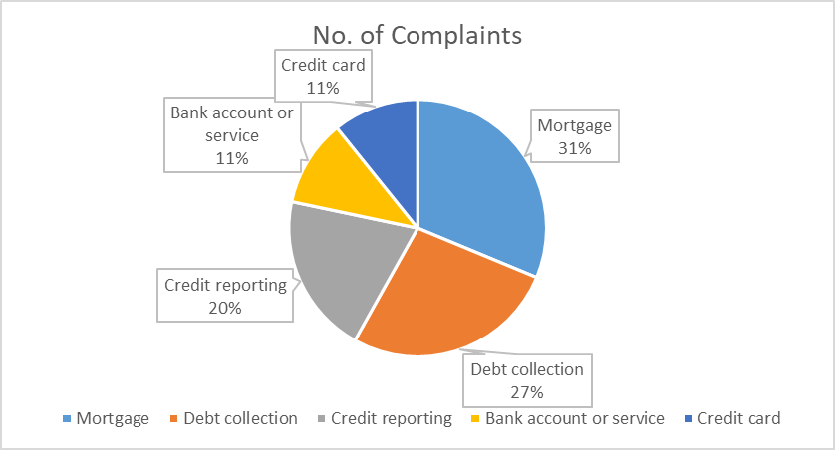
Visualization using Pie Chart:

Slide 29
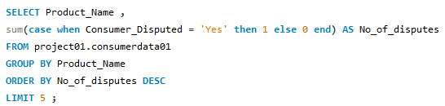
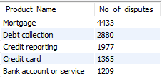
13.
Once they the team has addressed the issues faced by products with the most number of complaint, it set on to on identifying the product with the most disputes.
Run a query that return the top 5 products with most disputes along with the number of occurrences.
QUERY :
RESULT :

Slide 30
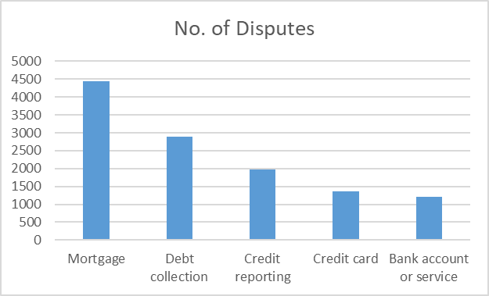
Visualization using Vertical Bar Graph:

Slide 31
Thank You!

Slide 32
Meet us at:
Aiman Mukhtar - LinkedIn - Email
Muhammad Waleed Yasin - LinkedIn - Email
Osama Yusuf Hassan - LinkedIn - Email
Umair Khalid - LinkedIn - Email
Ghazi Haider - Email

